Slide 1
Content
Degree of a Relationship
Unary Relationship
Binary Relationship
Ternary Relationship
Mapping Cardinality
Participation Constraint
References

Slide 2
The Relationship Type has these main Components:
Name of a relationship
Degree of a Relationship
Mapping Cardinality
Participation Constraints.

Slide 3
Degree of a Relationship
Degree: Express the number of entity sets associated (Participated) in relationship set.
One Unary
Two Binary
Three Ternary
e.g.:
employee manager-of employee is unary.
employee works-for department is binary.
Customer purchases items from a shop keeper.
Here customer purchase item, shop keeper is a ternary relationship

Slide 4
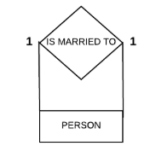
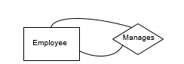
Unary Relationship
A unary relationship is represented as a diamond which connects one entity to itself as a loop.
E.g. : Some instances of employee manage other instances of Employee.
E.g.: person is married to person.

Slide 5
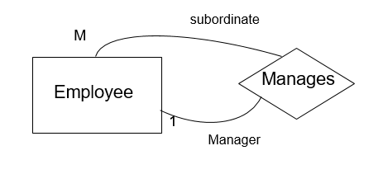
Unary Relationship
Role names may be added to make the meaning more explicit

Slide 6
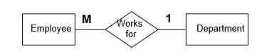
Binary Relationship
A relationship between two entity types

Slide 7
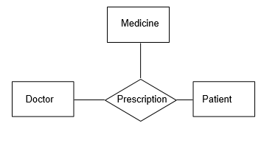
Ternary Relationship
A relationship connecting three entity types.

Slide 8
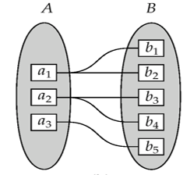
Mapping Cardinality
Express the number of entities to which other entities can be related via a relationship.
It is useful in describing relationship set of any degree.

Slide 9
Types Of Cardinality
One-to-One (1:1)
One-to-Many (1:N)
Many to One (M:1)
Many to Many (M:N)

Slide 10
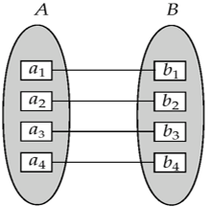
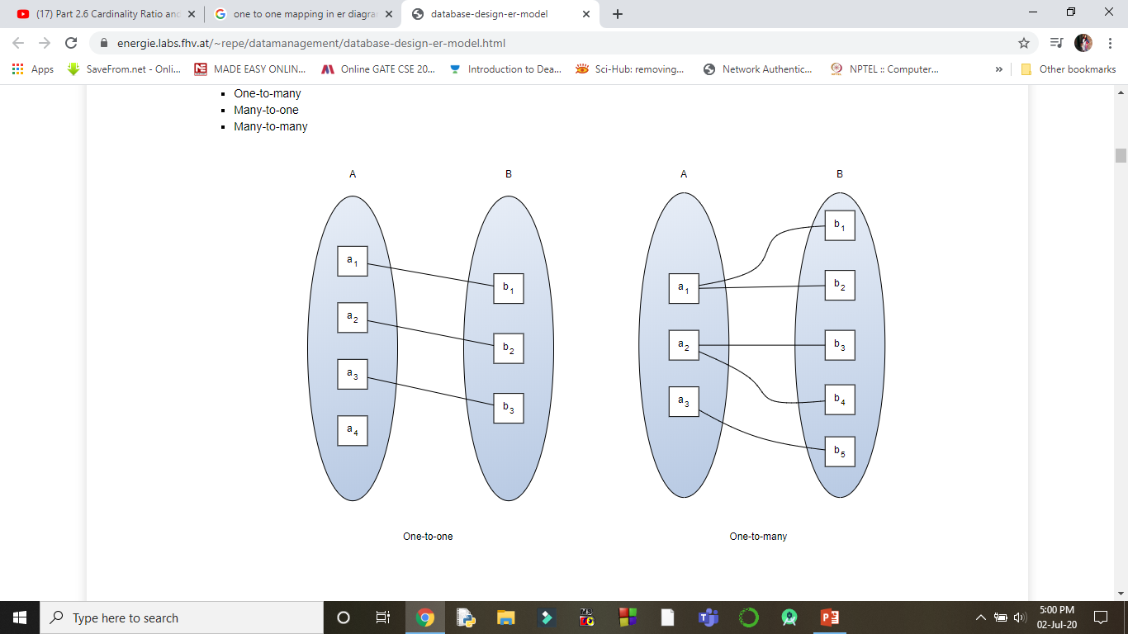
One-to-One (1:1)
One entity from entity set A can be associated with at most one entity of entity set B and vice versa.
For example, one Student can have only one college ID at a time.
Note: Some elements in A and B may not be mapped to any elements in the other set

Slide 11

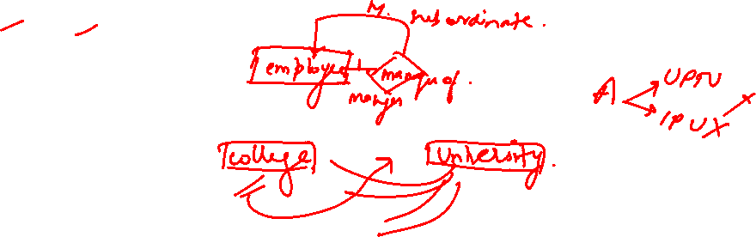
One-to-Many (1:N)
One entity from entity set A can be associated with multiple entities of entity set B, but an entity from entity set B can be associated with at most one entity.
For example, one class is consisting of multiple students.
Note: Some elements in A and B may not be mapped to any elements in the other set

Slide 12

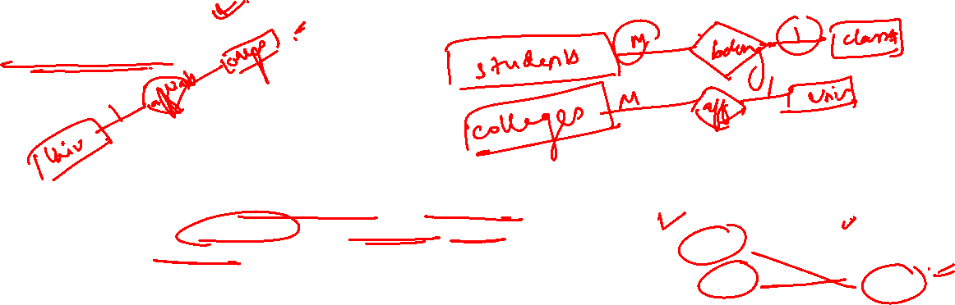
Many to One (M:1)
More than one entity from entity set A can be associated with at most one entity of entity set B. However, an entity from entity set B may or may not be associated with more than one entity from entity set A.
For example, many students belong to the same class.
Note: Some elements in A and B may not be mapped to any elements in the other set

Slide 13
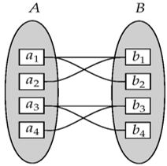

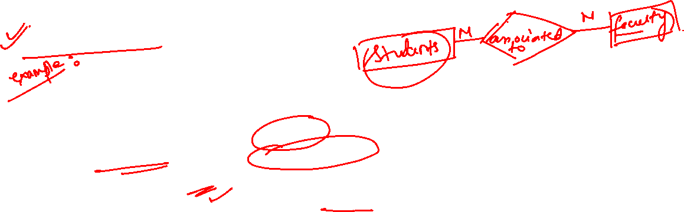
Many to Many (M:N)
One entity from set A can be associated with more than one entity from B and vice versa.
For example, Students as a group are associated with multiple faculty members, and faculty members can be associated with multiple students.
Note: Some elements in A and B may not be mapped to any elements in the other set

Slide 14
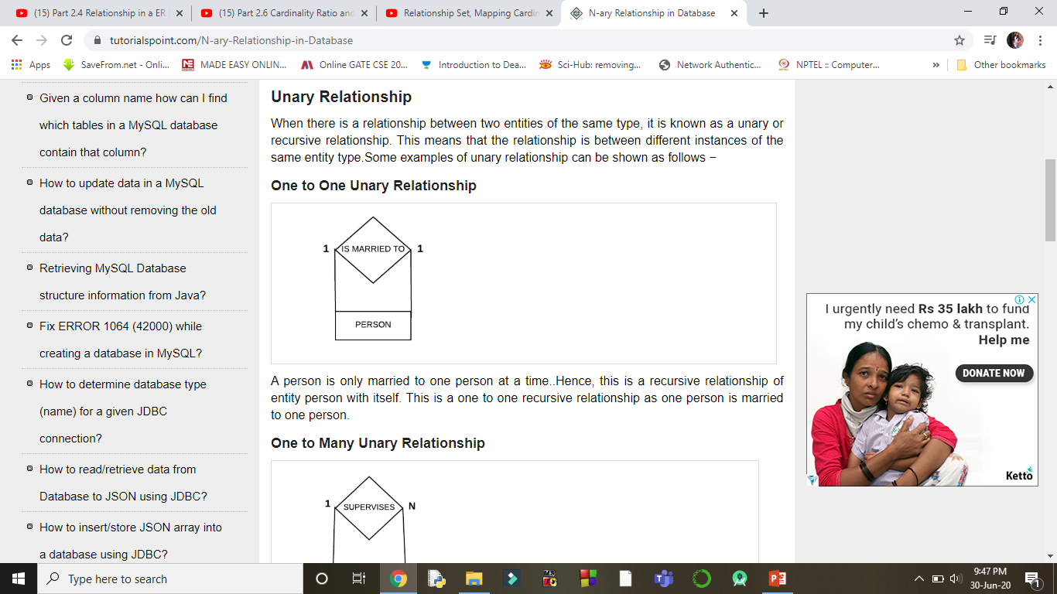
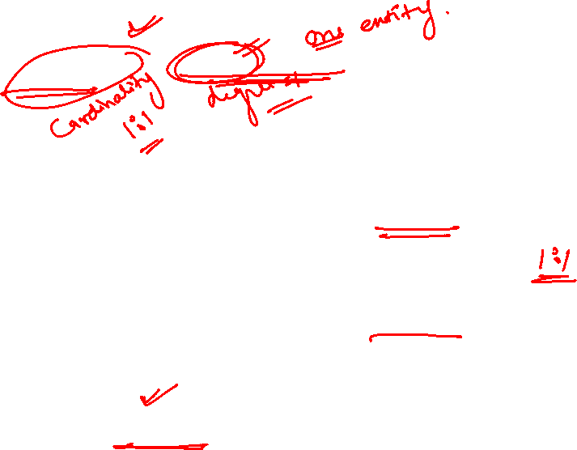
Example: One To One Unary Relationship
One to one recursive relationship as one person is married to one person at a time.

Slide 15

Example: One To Many Unary Relationship
This is a One to many recursive relationship as one employee Manages many employees in Department.

Slide 16
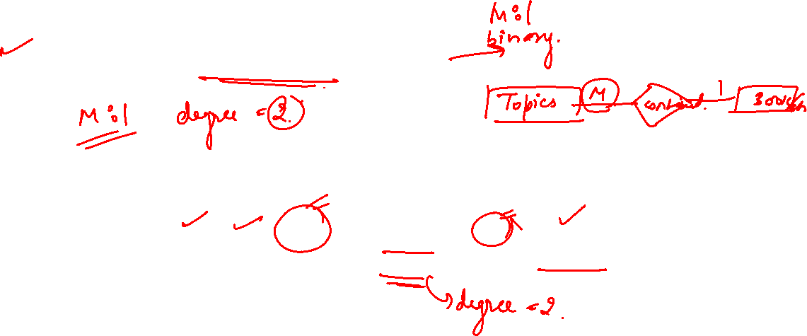
Example: Many To One Binary Relationship
Many employees work in a single department. Hence Many to One binary relationship where many employees works in one department.

Slide 17
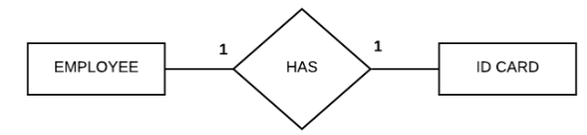
Example: One To One Binary Relationship
Each employee only has a single ID card. Hence this is a One to One binary relationship where One employee has One ID card.

Slide 18
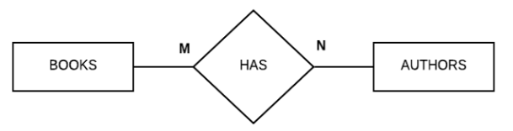
Example: Many To Many Binary Relationship
A book can have many authors or multiple authors may have written a single book.
So, there is a Many to Many relationship between books and authors as Many books have many authors.

Slide 19
Participation Constraint
Participation constraint specifies the existence of an entity when it is related to another entity in a relationship.
Minimum Cardinality: It defines minimum number of times an entity in an entity set participates in a relationship.
Maximum Cardinality: It defines maximum number of times an entity in an entity set participates in a relationship.
M
has
N
Movie
Actor
(1,8)
(0,4)
T.P.
P.P.

Slide 20
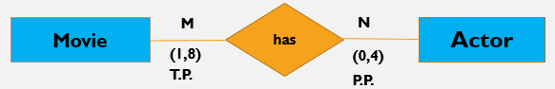
types of Participation constraint
There are two types of Participation constraint −
Total Participation: Each entity in the a entity set connected through the relationship to at least one entity in the other participating entity set. In other words, Every entity in an entity set participate in relationship.
Partial Participation : In any entity set if at least one entity is such type that it doesn’t participate in the relationship, then this type of participation of entity set is known as Partial Participation. In other words, Each entity in entity set may or may not occur in at least one relationship in a relationship set.

Slide 21
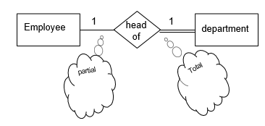
Example
Employee Head-of Department
Employee: partial
Department: total
All employees will not be head-of some department. So only few instances of employee entity participate in the above relationship. But each department will be headed by some employee.
So department entity’s participation is total and employee entity’s participation is partial in the above relationship.
Notes:
All instances of the entity type Employee don’t participate in the relationship, Head-of. Every employee doesn’t head a department. So, employee entity type is said to partially participate in the relationship.
But, every department would be headed by some employee. So, all instances of the entity type Department participate in this relationship. So, we say that it is total participation from the department side.

Slide 22
Summary
What is the Degree of a Relationship? And How to represent it.
Unary Relationship
Binary Relationship
Ternary Relationship
What is Mapping Cardinality?
one-to-one
one-to-many
many-to-one
many-to-many
Relationship Participation Constraints and it’s types-
Total Participation
Partial Participation

